Slide 1
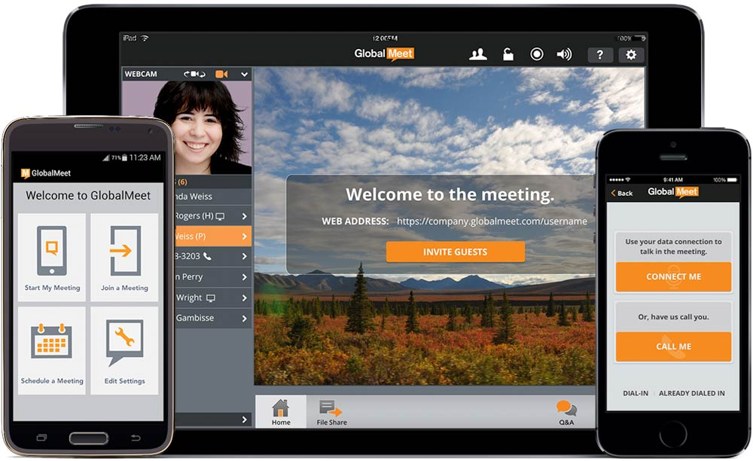
Do Post online delivery mobile application
Chathuranga d.m.s. (e/13/043)
Gajanayake h.u.p. (e/13/106)
Sandeepa a.m.h. (e/13/319))

Slide 2

Why we need do post?

Slide 3
Why do post?
High demand : people have frequently asked About these kind of applications . Mostly university student.
Curiosity : curiosity among our batch mates to learn about THIS

Slide 4

Our solution is,

Slide 5

An Android Application on mobile phones
This project consists of a mobile application which allows the person to either act like a delivery person or a customer who wants to buy something from a shop which is situated far away. The delivery person gets a payment if he successfully delivers the item. Customers can see who are the online delivery persons and select one of them according to their ratings.

Slide 6
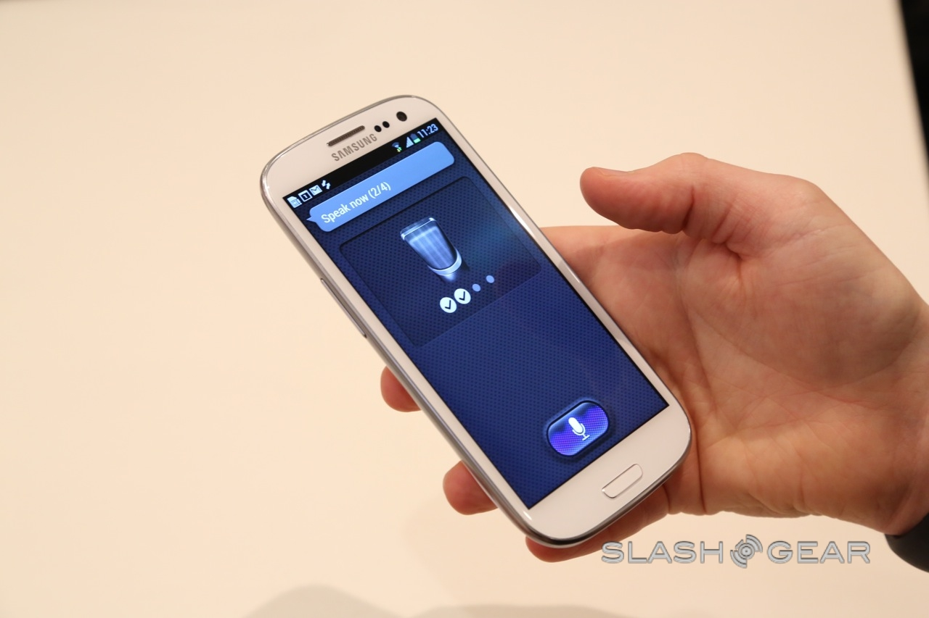
requirements
Android application developing
Java servlet
mysql

Slide 7
Expected outcomes
An android application which is user friendly
Safely receiving an item which is in the online market
Connecting people via a trusted circle of service

Slide 8
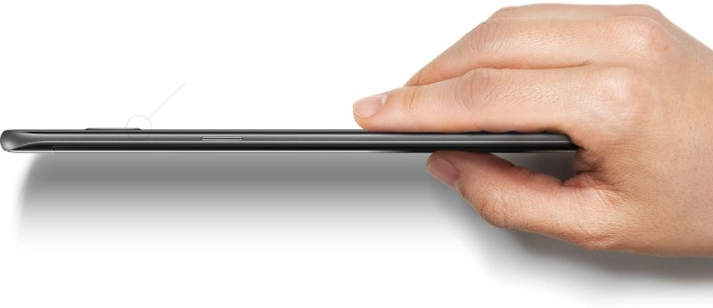
Thank you !

